Slide 1

A Generative Adversarial Framework for Bounding Confounded Causal Effects
Yaowei Hu¹, Yongkai Wu², Lu Zhang¹, Xintao Wu¹
¹University of Arkansas
²Clemson University

Slide 2



Causal Inference
Economics
Healthcare
Fair Machine Learning
Inferring causal effects from observational data is an important task in many fields.
Pearl’s structural causal model is a decent and widely adopted framework for conducting causal inference.

Slide 3
Inferring Causal Effects
block
C
confounding effects
A
B
intervention
outcome
causal effects
Under the assumption of no hidden confounding, the ACE can be calculated using the well-known back-door criterion.

Slide 4
Inferring Causal Effects
In an unidentifiable situation, any estimation of ACEs only based on the observational distribution is not guaranteed to be correct.
confounding effects
Confounders
A
B
causal effects
When hidden confounders exist, the ACE may not be uniquely calculated from the observational data without further assumptions, known as the unidentifiable problem.

Slide 5
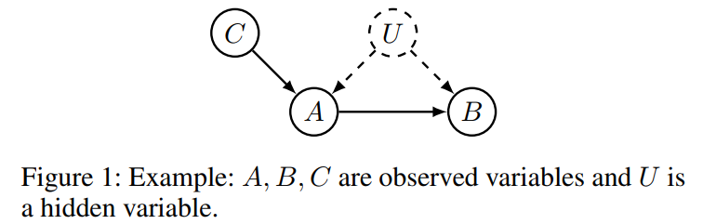
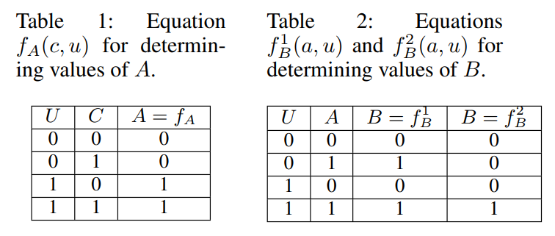
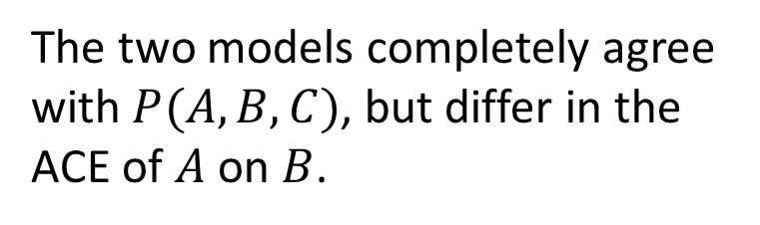
Unidentifiable Problem
Causal graph
Unidentifiable Problem
The two models completely agree with $P(A, B, C)$, but differ in the ACE of $A$ on $B$.
Two different causal models

Slide 6
Previous Work on Bounding ACE
[Balke and Pearl, 1997] developed a constrained optimization problem for discovering bounds from the observational data.
The general idea is to shift the randomness of the causal model from the distributions of 𝑼 to the distributions of mappings, and then use linear programming to search for distributions that lead to lower or upper bound of the ACE.
Limitations: limited to categorical endogenous variables and cannot directly extend to the continuous domain.

Slide 7
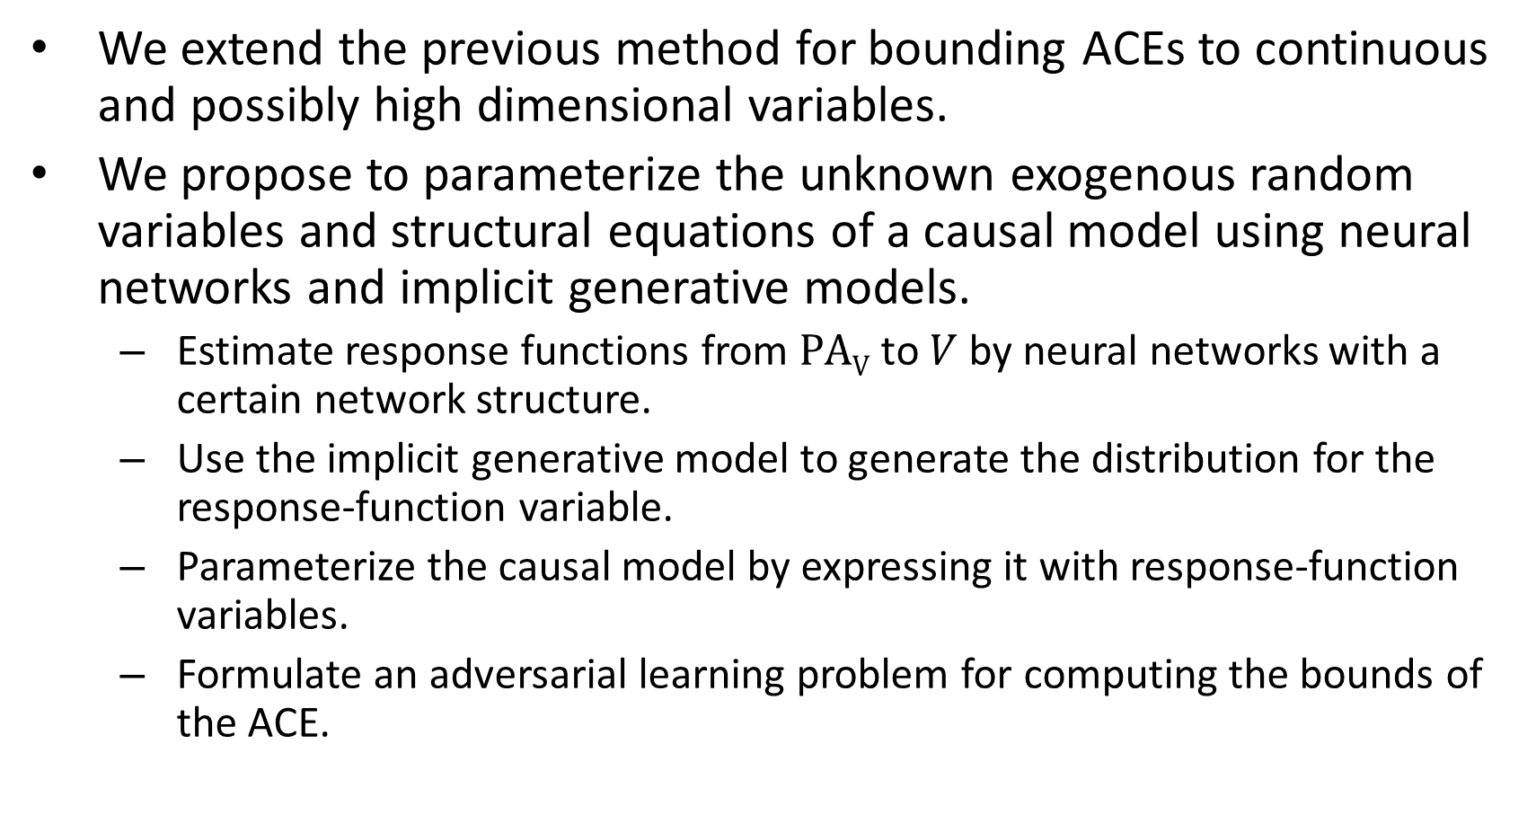
Our Work
We extend the previous method for bounding ACEs to continuous and possibly high dimensional variables.
We propose to parameterize the unknown exogenous random variables and structural equations of a causal model using neural networks and implicit generative models.
Estimate response functions from $PAV$ to $V$ by neural networks with a certain network structure.
Use the implicit generative model to generate the distribution for the response-function variable.
Parameterize the causal model by expressing it with response-function variables.
Formulate an adversarial learning problem for computing the bounds of the ACE.

Slide 8

Response-function
Response-function
To partition the domain of each exogenous variable into a limited number of equivalent classes, each inducing a distinct functional mapping between endogenous variables. These functional mappings are called the response functions.
U
y=x
y=0
y≠x
y=1
X
Y
Domain of $U$

Slide 9


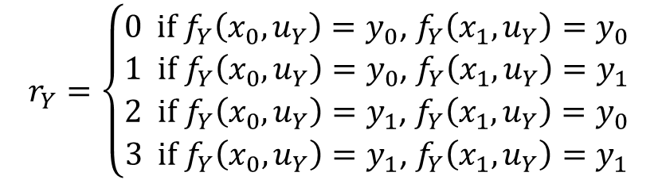
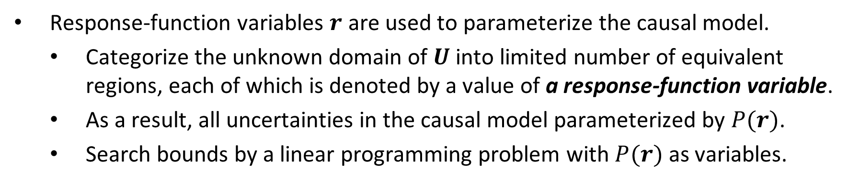
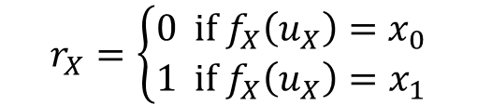


Response-function Variables
Response-function variables $r$ are used to parameterize the causal model.
Categorize the unknown domain of $U$ into limited number of equivalent regions, each of which is denoted by a value of a response-function variable.
As a result, all uncertainties in the causal model parameterized by $P(r)$.
Search bounds by a linear programming problem with $P(r)$ as variables.
Example
$$r_{X}=\left\{\begin{aligned}0 if f_{X}\left(u_{X}\right)=x_{0} \\ 1 if f_{X}\left(u_{X}\right)=x_{1}\end{aligned}\right.$$
$$U_{X}$$
$$U_{Y}$$
$$r_{Y}=\left\{\begin{aligned}0 if f_{Y}\left({x_{0}, u}_{Y}\right)=y_{0}\text{,} f_{Y}\left({x_{1}, u}_{Y}\right)=y_{0} \\ 1 if{ f}_{Y}\left({x_{0},u}_{Y}\right)=y_{0}\text{, }f_{Y}\left({x_{1}, u}_{Y}\right)=y_{1} \\ 2 if f_{Y}\left({x_{0}, u}_{Y}\right)=y_{1}\text{, }f_{Y}\left({x_{1}, u}_{Y}\right)=y_{0} \\ 3 if f_{Y}\left({x_{0},u}_{Y}\right)=y_{1}\text{, }f_{Y}\left({x_{1}, u}_{Y}\right)=y_{1}\end{aligned}\right.$$
$$X$$
$$Y$$

Slide 10
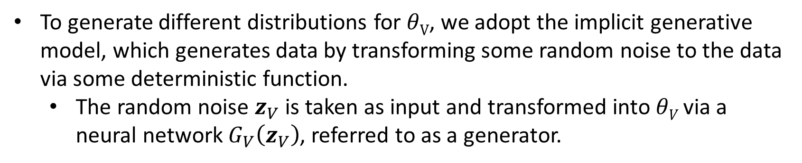
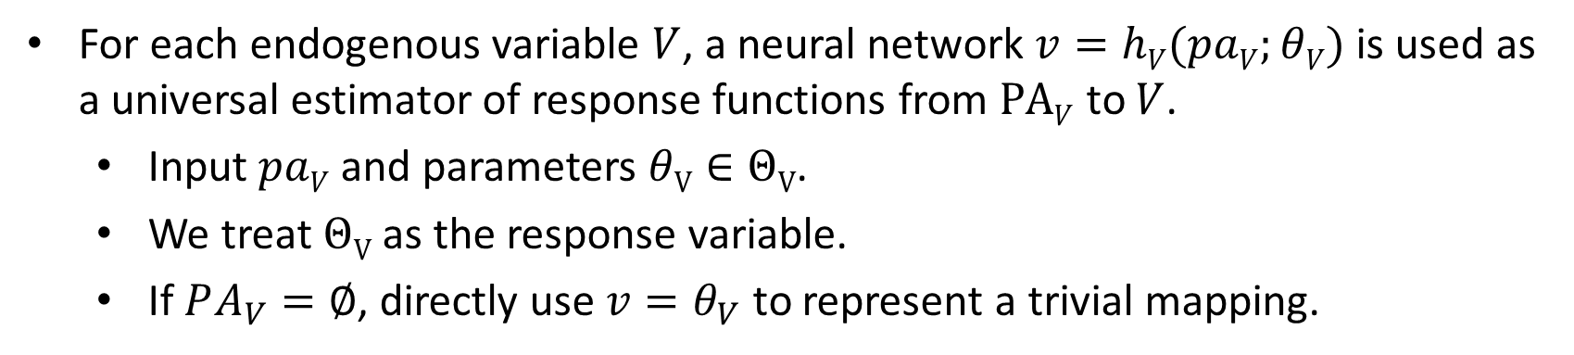
Coping with Continues Domain
For each endogenous variable $V$, a neural network $v=hV(paV;θV)$ is used as a universal estimator of response functions from $PAV$ to $V$.
Input $paV$ and parameters $θV∈ΘV$.
We treat $ΘV$ as the response variable.
If $PA_{V}=∅$, directly use $v=θ_{V}$ to represent a trivial mapping.
To generate different distributions for $θV$, we adopt the implicit generative model, which generates data by transforming some random noise to the data via some deterministic function.
The random noise $z_{V}$ is taken as input and transformed into $θV$ via a neural network $G_{V}\left(z_{V}\right)$, referred to as a generator.

Slide 11
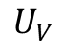
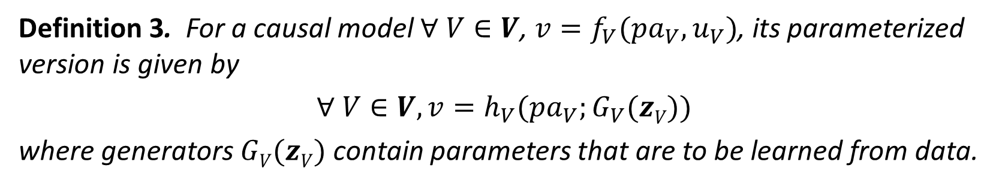
Parameterizing Causal Models
Obtain an implicit generative model for each $V∈V$:
$$v=h_{V}(pa_{V};G_{V}(z_{V}))$$
$$U_{V}$$
Definition 3. For a causal model $∀ V∈V$, $v=f_{V}(pa_{V}, u_{V})$, its parameterized version is given by
$∀ V∈V, v=h_{V}(pa_{V};G_{V}(zV))$
where generators$GV(zV)$ contain parameters that are to be learned from data.

Slide 12
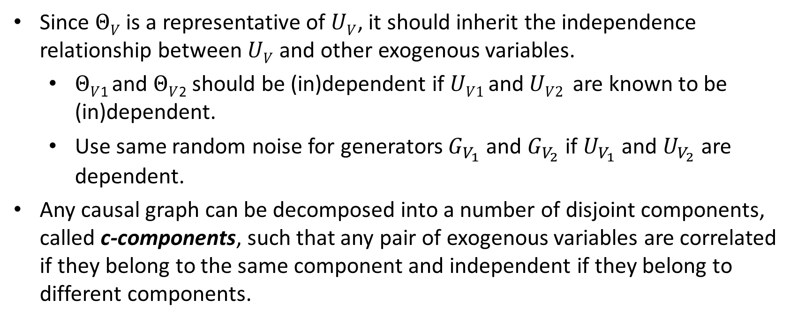
Encoding Independence Assumptions
Since $ΘV$ is a representative of $UV$, it should inherit the independence relationship between $UV$ and other exogenous variables.
$ΘV$₁ and $ΘV$₂ should be (in)dependent if $UV1$ and $UV2$ are known to be (in)dependent.
Use same random noise for generators $G_{V_{1}}$ and $G_{V_{2}}$ if $U_{V_{1}}$ and $U_{V_{2}}$ are dependent.
Any causal graph can be decomposed into a number of disjoint components, called c-components, such that any pair of exogenous variables are correlated if they belong to the same component and independent if they belong to different components.
c-component
U
c-component
C
A
B

Slide 13
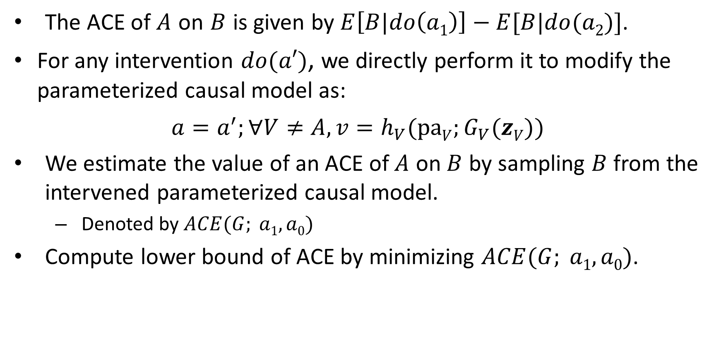
Bounding ACEs
The ACE of $A$ on $B$ is given by $E\left[B|do\left(a1\right)\right]−E[B|do(a2)]$.
For any intervention $do(a′)$, we directly perform it to modify the parameterized causal model as:
$a=a^{′};∀V≠A, v=h_{V}(paV;G_{V}(zV))$
We estimate the value of an ACE of $A$ on $B$ by sampling $B$ from the intervened parameterized causal model.
Denoted by $ACE(G; a1, a0)$
Compute lower bound of ACE by minimizing $ACE(G; a1, a0)$.

Slide 14
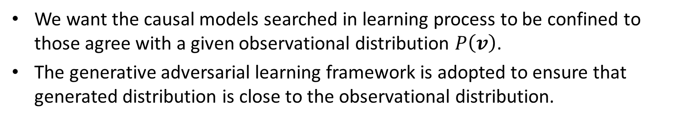
Bounding ACEs
We want the causal models searched in learning process to be confined to those agree with a given observational distribution $P\left(v\right)$.
The generative adversarial learning framework is adopted to ensure that generated distribution is close to the observational distribution.
A discriminator is trained to minimize the discrepancy between the generated distribution and the observational distribution.
The objective function is given by $\max_{D}{V\left(G, D\right)}$where
$$V (G; D)=Ev∼P\left(v\right)[log⁡D(v)]+Ez∼P\left(z\right) [log⁡(1−D(G(z)))]$$

Slide 15
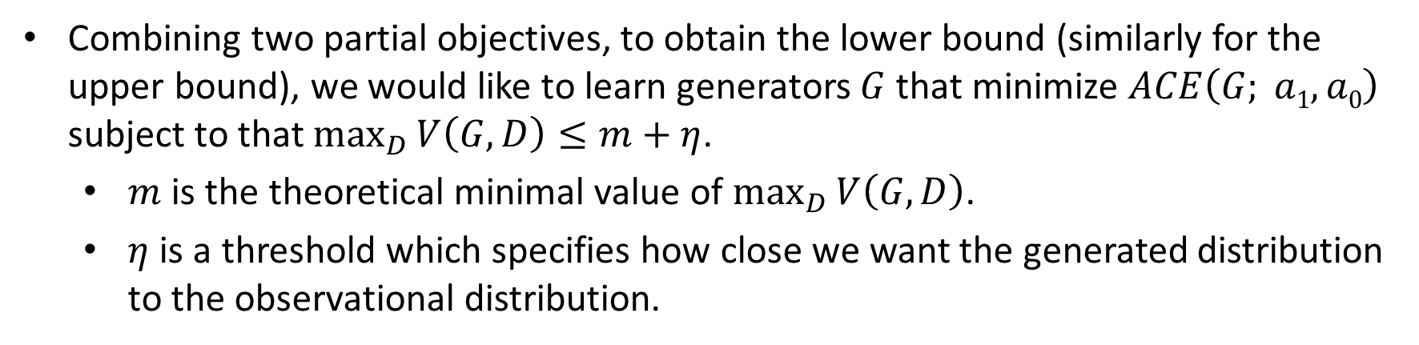
Bounding ACEs
Combining two partial objectives, to obtain the lower bound (similarly for the upper bound), we would like to learn generators $G$ that minimize $ACE\left(G; a1, a0\right)$ subject to that $\max_{D}{V\left(G, D\right)}≤m+η$.
$m$ is the theoretical minimal value of $\max_{D}{V\left(G, D\right)}$.
$η$ is a threshold which specifies how close we want the generated distribution to the observational distribution.
Problem 1. Given a causal graph and the data, the lower bound (similarly for the upper bound) of the ACE of $A$ on $B$ is computed by solving the optimization
$$\min_{G}{\max_{λ≥0}{\max_{D}{\{ACE\left(G;a1, a0\right)+λ(V\left(G, D\right)−m−η\}}}}$$

Slide 16
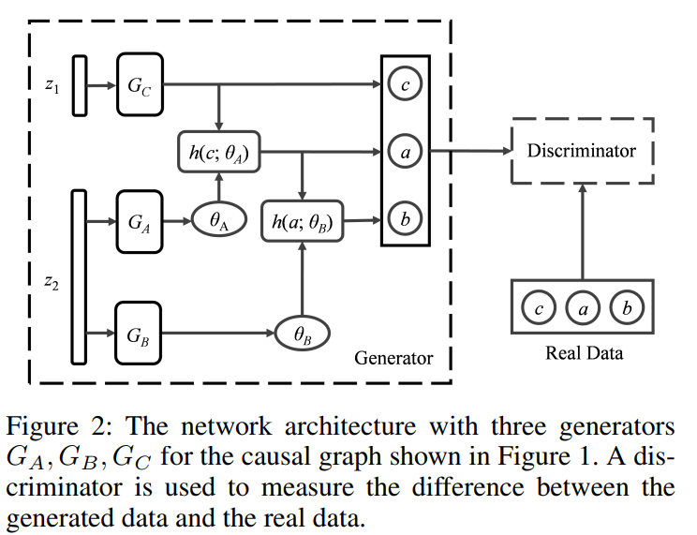
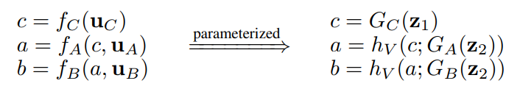
Example
Causal graph and equations
Architecture of neural networks
c-component
U
c-component
C
A
B

Slide 17
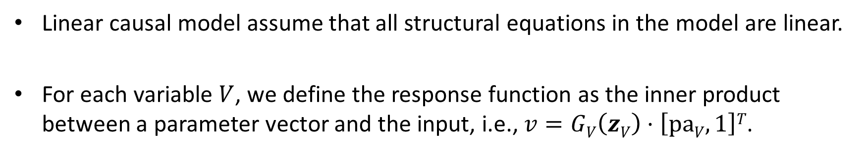
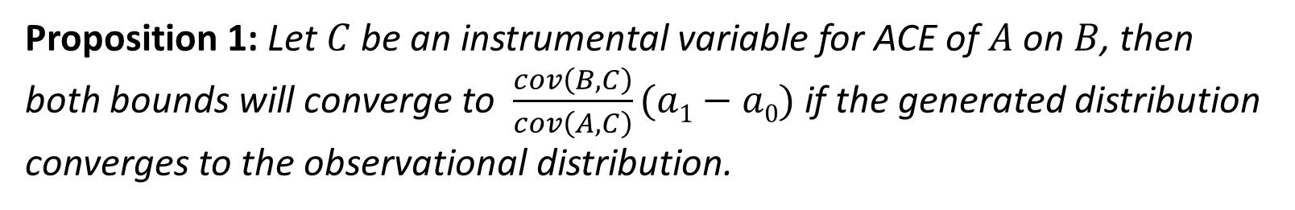
Linear Causal Models: A Special Case
Linear causal model assume that all structural equations in the model are linear.
For each variable $V$, we define the response function as the inner product between a parameter vector and the input, i.e., $v=GV\left(zV\right)·\left[paV, 1\right]T$.
Proposition 1: Let $C$ be an instrumental variable for ACE of $A$ on $B$, then both bounds will converge to $\frac{cov\left(B, C\right)}{cov\left(A, C\right)}(a1−a0)$ if the generated distribution converges to the observational distribution.

Slide 18
Experiments
Experiments are conducted on synthetic and real-world data.
Baselines:
Linear/logistic regression: We build a linear/logistic regression on the outcome using all observed variables, and then compute the ACE based on the coefficient of the treatment variable.
Instrumental variable estimation: We implement this method following the classic instrumental variable formula.
Propensity score adjusted regression: We adopt the propensity score adjusted regression and follow other method to handle continuous variables.

Slide 19
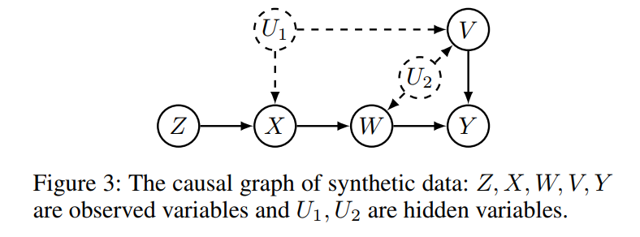
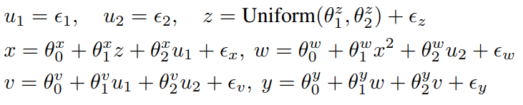
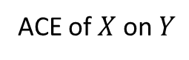
Experiments
Synthetic Data:
ACE of $X$ on $Y$
Structural Equations:

Slide 20
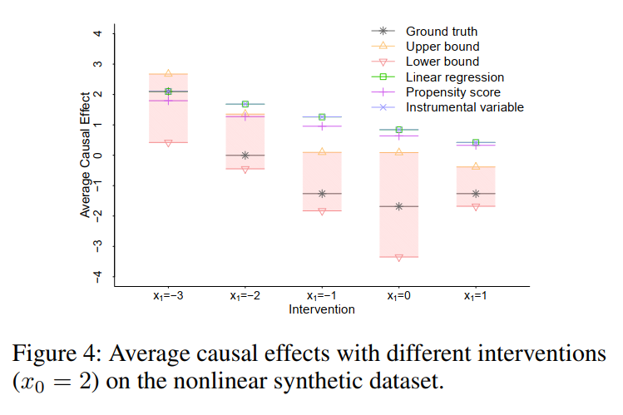
Experiments
Results of Synthetic Data:
Our upper bound and lower bound cover the ground truth in all interventions.
Other baseline methods cannot produce accurate estimations and fall outside the bounds in most cases.

Slide 21
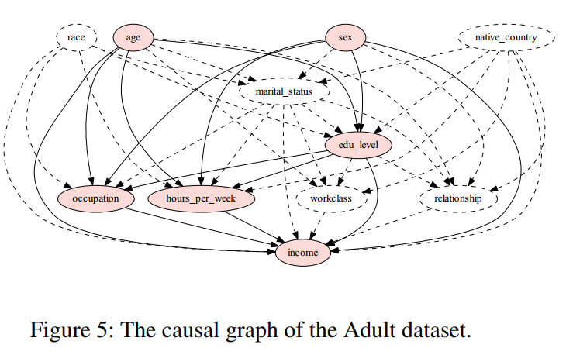
Experiments
Adult Data:
ACE of edu_level on income
Tool: TETRAD for building the causal graph (using the classic PC algorithm)

Slide 22
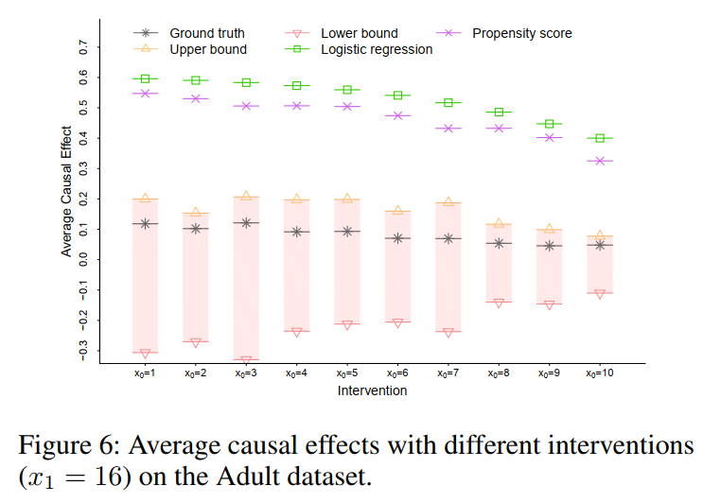
Experiments
Results of Adult Data:
The ground truth falls in the range of the upper bound and lower bound in all interventions.
Other baseline methods including the logistic regression and propensity score cannot produce accurate estimations and fall outside the bounds in all cases.

Slide 23
Conclusions
Proposed a bounding method for estimating average causal effects (ACEs) from observational data with hidden confounding.
Parameterized the causal model using implicit generative models and builds an adversarial network to formulate a constrained optimization problem for computing the bounds.
Showed that encoding the linear assumption can make the bounds converge to a fixed value.
Conducted experiments on both synthetic and real-world datasets.

Slide 24





A Generative Adversarial Framework for Bounding Confounded Causal Effects
Yaowei Hu
Yongkai Wu
Lu Zhang
Xintao Wu
This work was supported in part by NSF 1646654, 1920920, and 1946391.

